Slide 1
CS47: Cross-Platform Mobile Development
Lecture 4A: Third-Party Components and Expo Libraries
James Landay
Ryan Chen
Julia Rose Chin
Nadin Tamer
Ruslan AlJabari
Alix Cui
Winter 2022
https://cs47.stanford.edu
Notes:
Share the pres: https://docs.google.com/presentation/d/1AvDEb3ex6o8BSuO8fc07WgfCPn1uWxLFvJR6KoZKVJg/edit?usp=sharing
Record lecture!

Slide 2
Logistics ⚙️
Assignment 2 released, due this Thursday (27th, 11:59 PM)
Submit via Canvas
You are allowed 2 late days (each late day is 24 hours)
Github Handout
Keep on asking questions on Ed!
Pinned post for A2 updates!
Come to office hours with any questions!
Office hours schedule

Slide 3
Roadmap 🗺
Review: user-interactive components
Third-party components
Why use them?
Where to find them
How to install them
Reading documentation
Your turn!

Slide 4
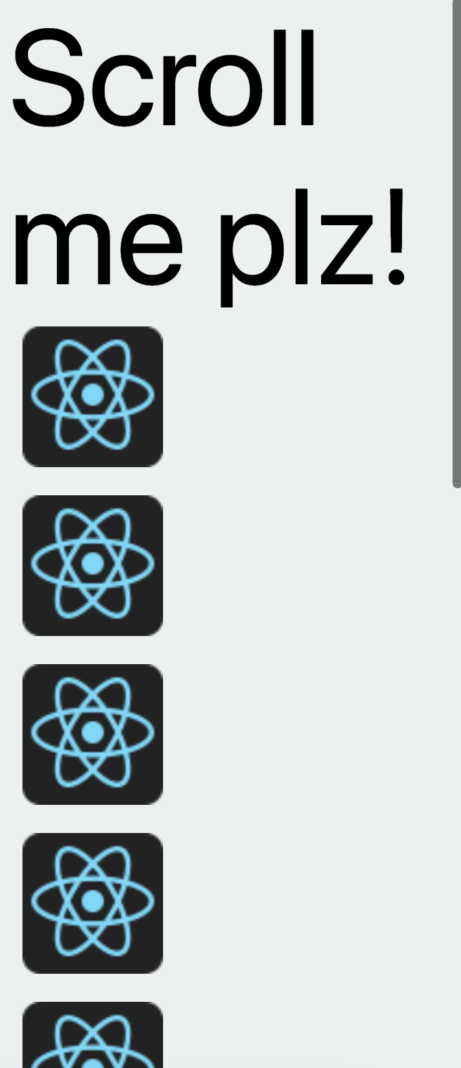
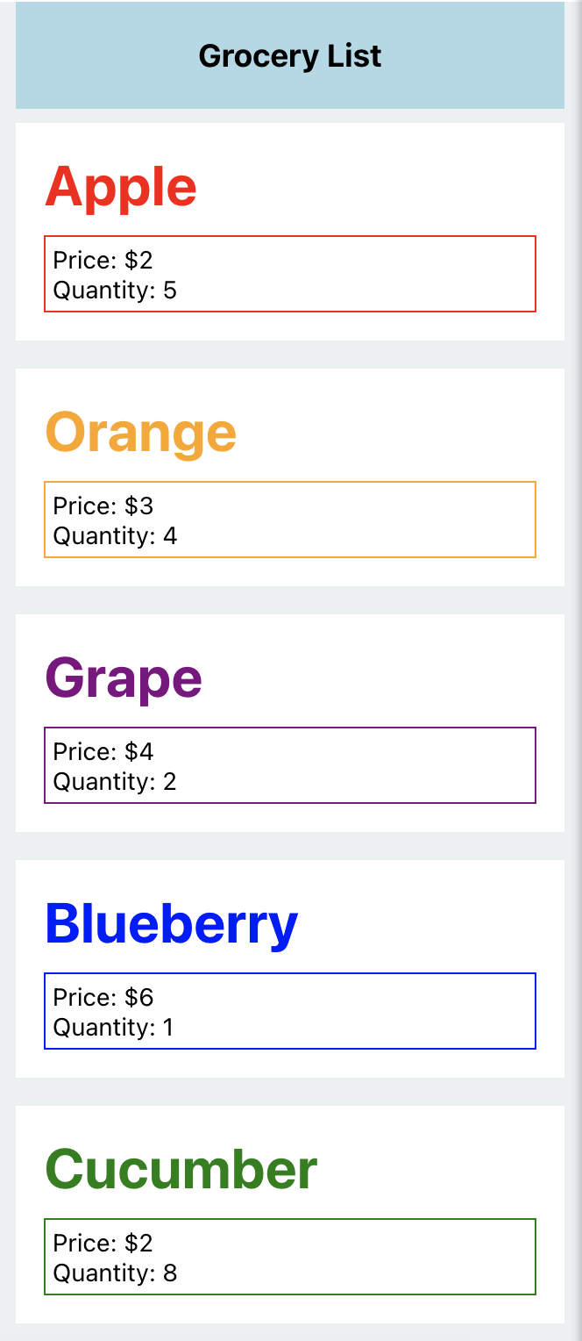
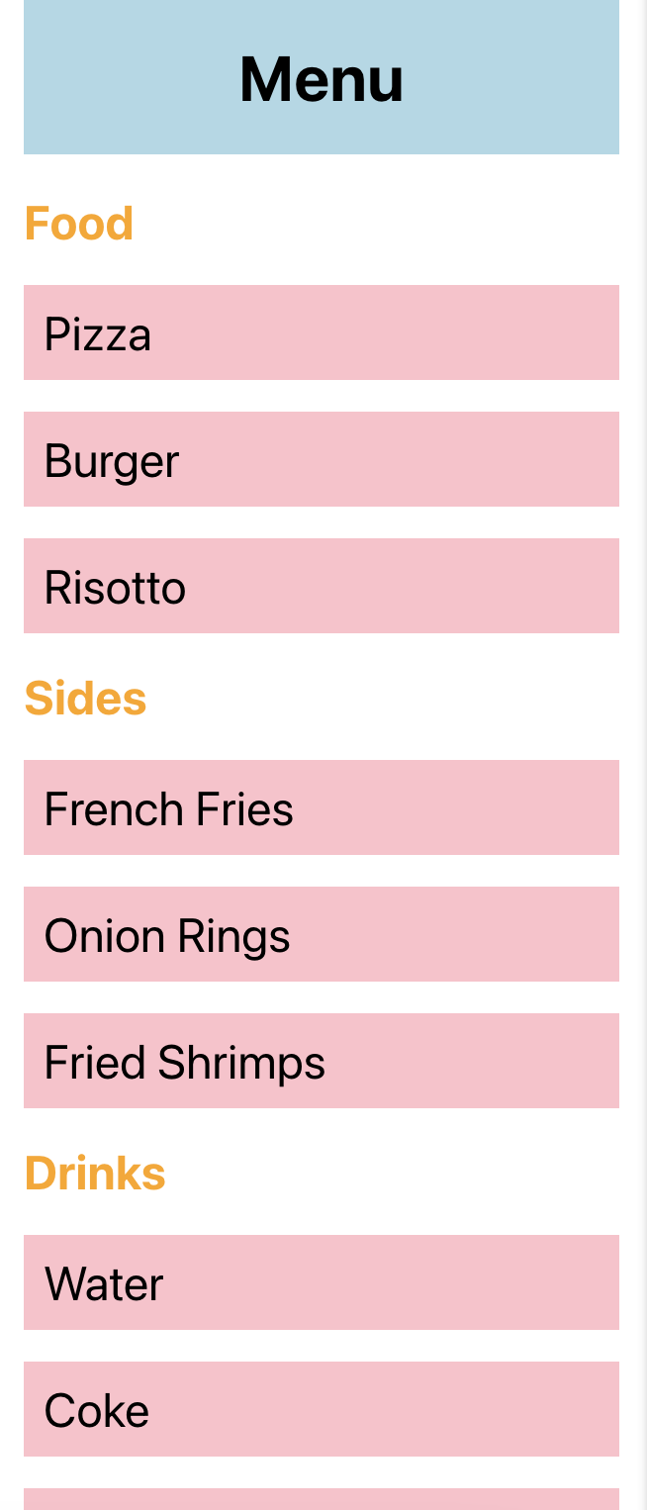
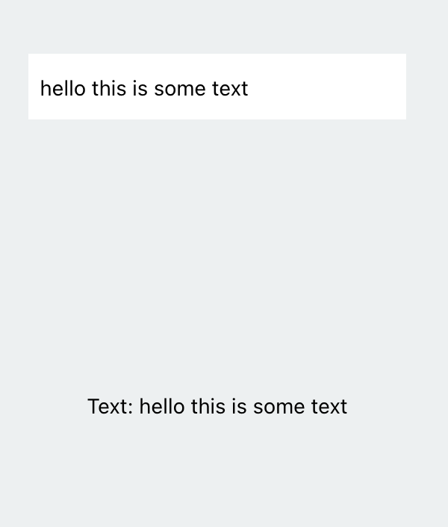
Review: User-interactive components
TextInput
(Snack example)
ScrollView
(Snack example)
FlatList
(Snack example)
SectionList
(Snack example)

Slide 5
Components
React Native core components (View, Text, Image, FlatList, etc.)
There are more components that we haven’t covered in lecture, so definitely go through this list at some point to check out what other components you can use!
e.g. ImageBackground, TouchableOpacity, ActivityIndicator, Switch
Custom components (e.g. GroceryItem from Lecture 3B)
Third-party components → today!

Slide 6
Third-Party Components
No need to re-invent the wheel
Developers have already implemented many different libraries with components / interactions you might want to include in your app 🤩
A few examples:
Calendar
Chat
Swiping
Maps
Custom UI components
Don’t be shy about using third-party components – they will make your life a lot easier! 🤗

Slide 7
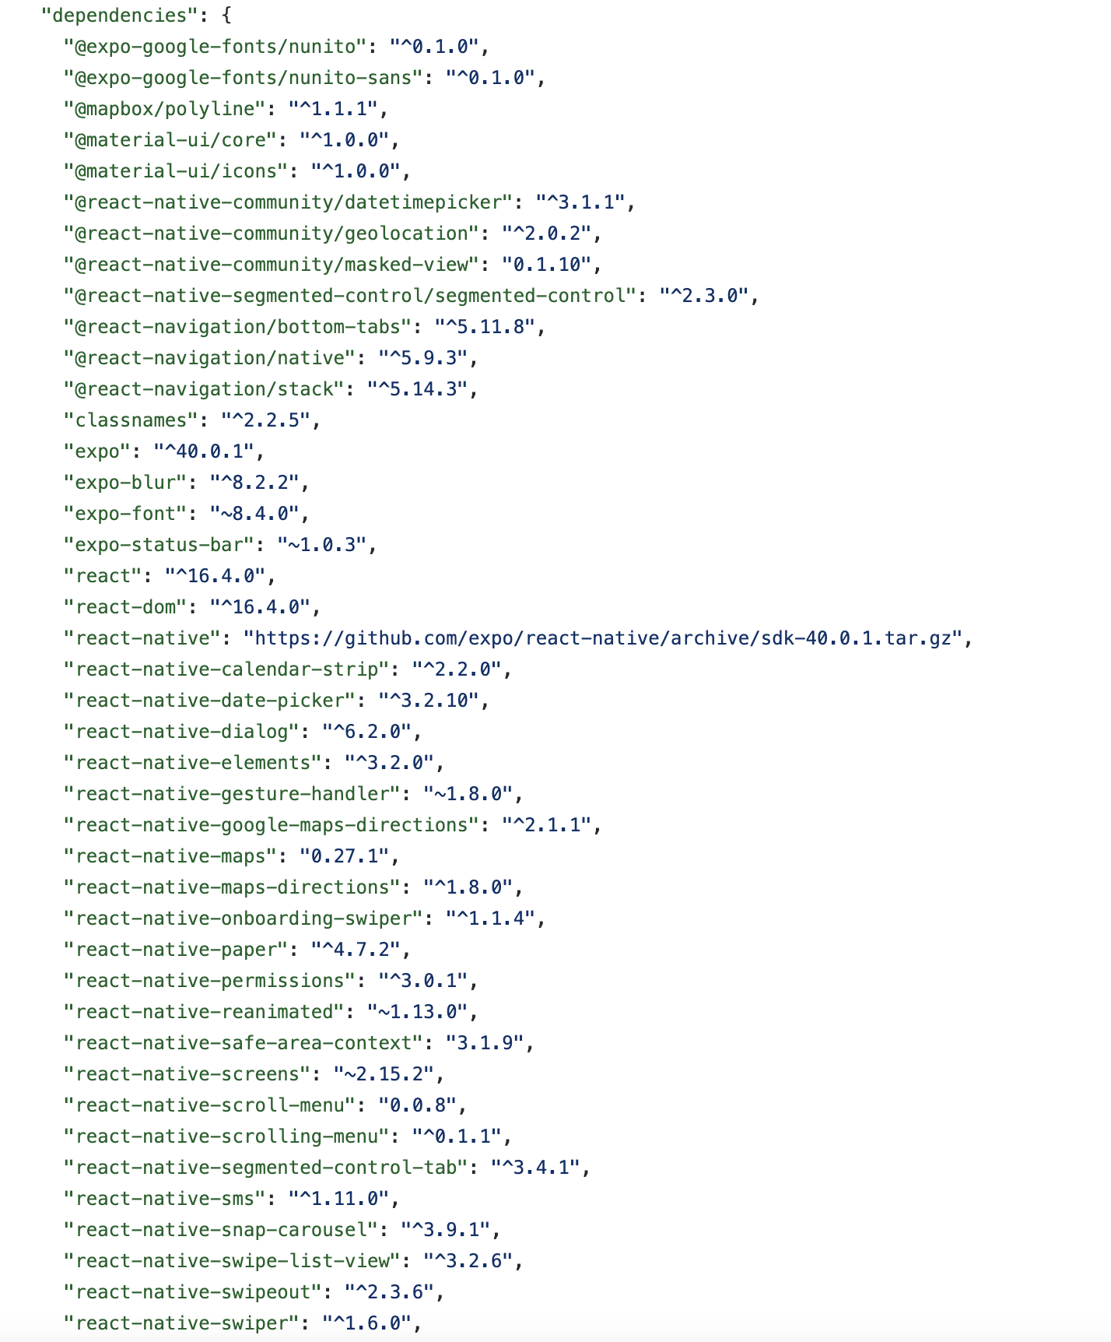
Third-Party Components
An excerpt from the dependencies of my team’s CS147 final project last year – we used a lot of third-party components!

Slide 8
Third-Party Components
Where can we find third-party components to use in our apps?
Expo SDK (see list on the left sidebar)
React Native Directory
npm registry
Useful link: https://docs.expo.dev/workflow/using-libraries/

Slide 9
Third-Party Components
Word of warning: Not all libraries you find online will be compatible with React Native and/or Expo ⚠️
On React Native Directory, check for the ✔️ Expo Go flag (link above is already filtered)
Otherwise, check the GitHub repo for the library for the following:
Is there an ios/ or android/ directory?
Does the README mention linking (react-native link)?
Is it built specifically for Node.js, the web, electron, or some other platform?
If you answered yes to any of these, the library may be incompatible with Expo.
You can always try installing the library and using it to confirm whether or not it is compatible!
Useful link: https://docs.expo.dev/workflow/using-libraries/

Slide 10
Third-Party Components
Use expo install as opposed to npm install or yarn add
This command allows Expo to pick a compatible version of the library and will also warn you about any known incompatibilities!
Generally fine to use even if installation instructions say npm install (expo install is basically just npm install under the hood with some extra checks)
Make sure to run installation commands in the project directory!
Follow any other commands outlined in the README for setup
✨ cd [APP-DIRECTORY]
✨ expo install [LIBRARY-NAME]

Slide 11
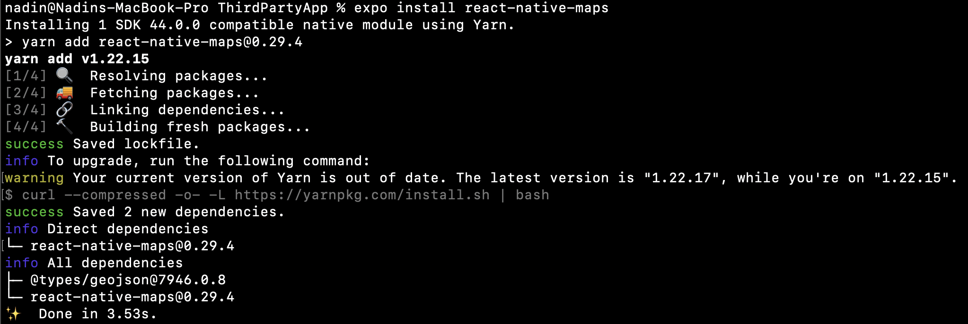
Third-Party Components
Example output of installing the react-native-maps library

Slide 12
Third-Party Components
Example output of installing the react-native-maps library

Slide 13
Demo – Icons
@expo/vector-icons library is installed by default in projects created using expo init
Browse icons on https://icons.expo.fyi/
Follow directions to display icon component in your app
Useful link: https://docs.expo.dev/guides/icons/

Slide 14
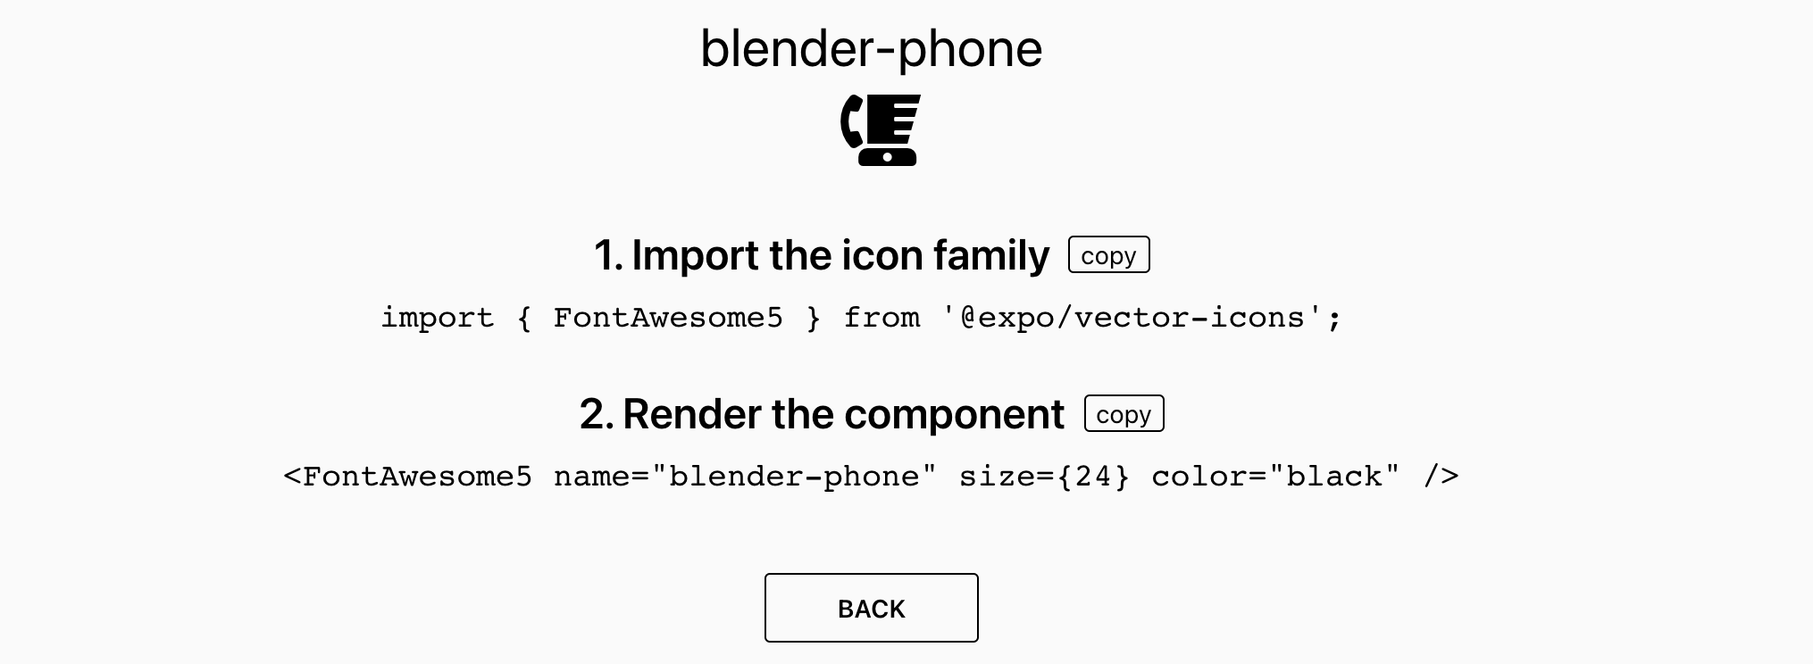
Demo – Icons
Useful link: https://docs.expo.dev/guides/icons/

Slide 15
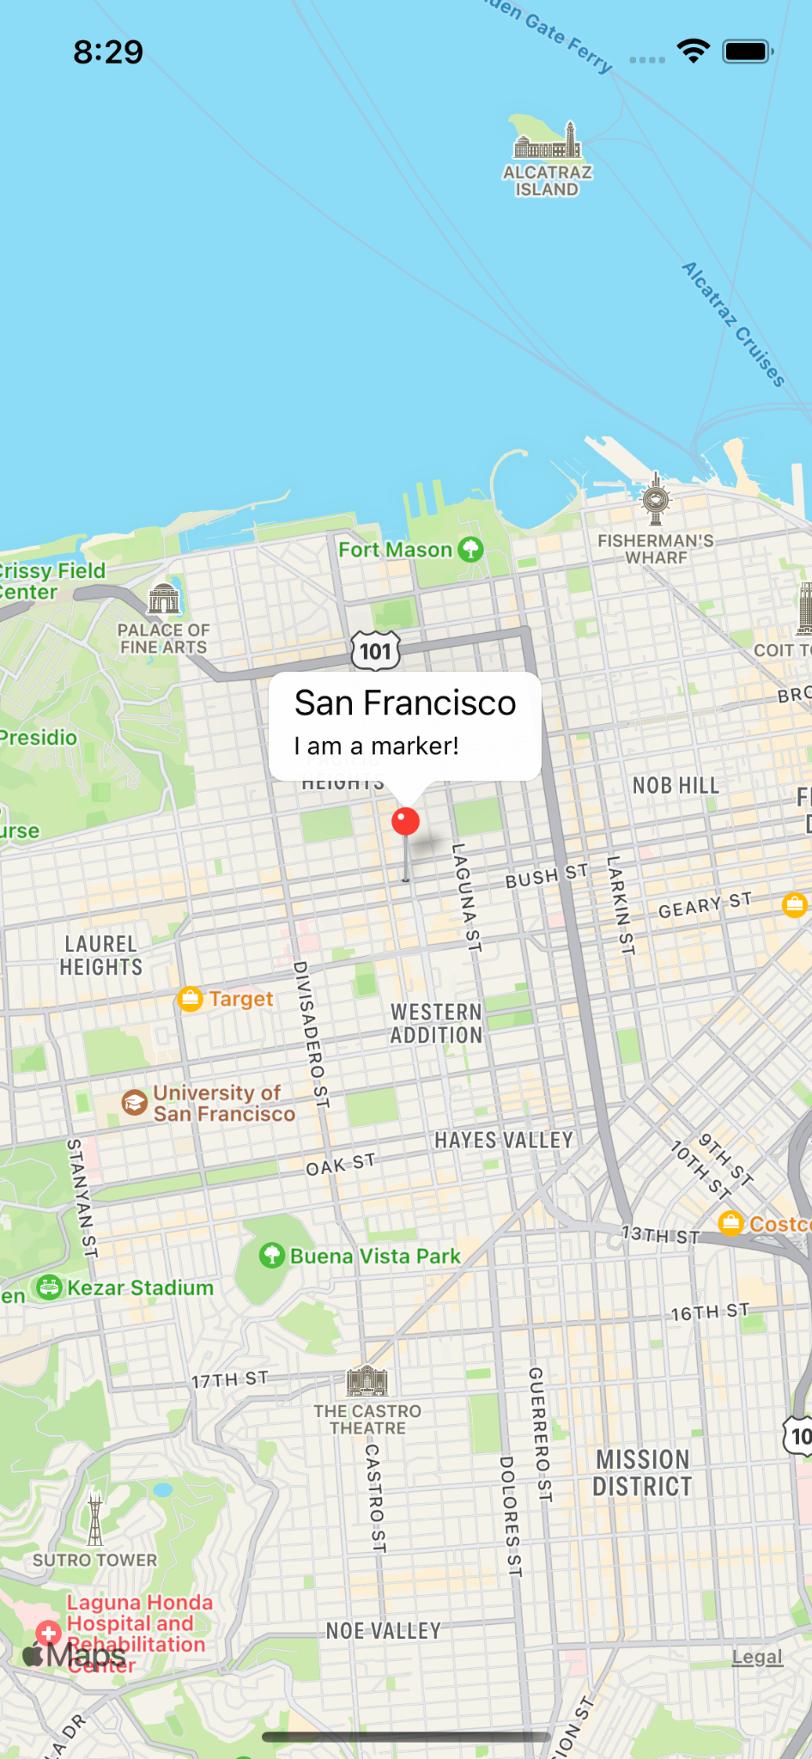
Demo – react-native-maps
React Native Map components for iOS + Android
Install using expo install react-native-maps
Can use Apple Maps or Google Maps for iOS, must use Google Maps for Android
Need a Google API key to use Google Maps
MapView, Marker, and other components
GitHub link: https://github.com/react-native-maps/react-native-maps

Slide 16
Reading Documentation
Installation instructions
Example code for basic setup
Full documentation for each component and its props
FAQ/Troubleshooting section
Check “Issues” tab on GitHub for possible solutions to bugs

Slide 17
Q&A

Slide 18
Your turn!
Try out the react-native-calendars library!
https://github.com/wix/react-native-calendars
Create a new expo app using expo init
Install the library and display a calendar component in your app
Read through the documentation for tips on how to import and display the calendar component 💡
Play around with different props & styling

Slide 19

Exit ticket
https://forms.gle/EcdLPFRawcWkG6f58

Slide 20
Next time
Navigation

